Slide 1




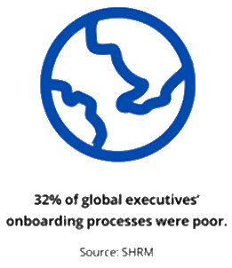
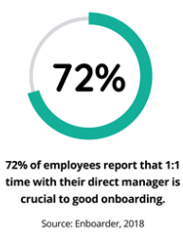
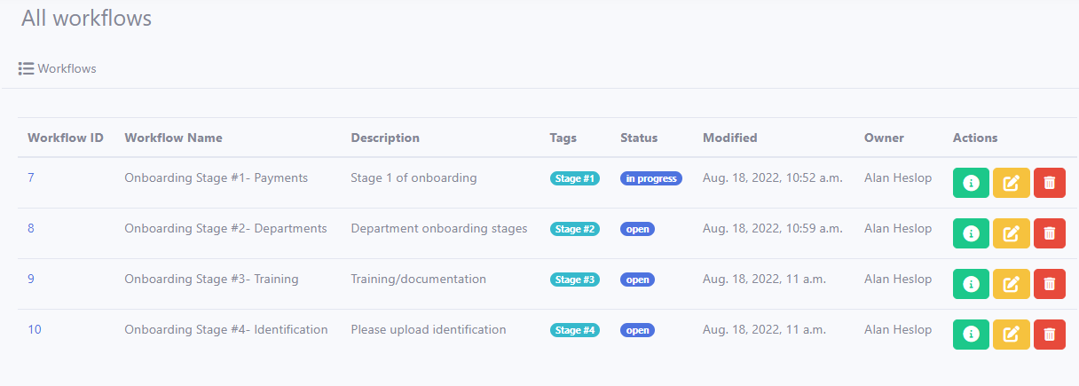
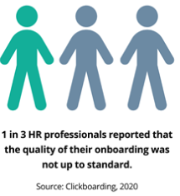
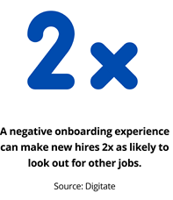
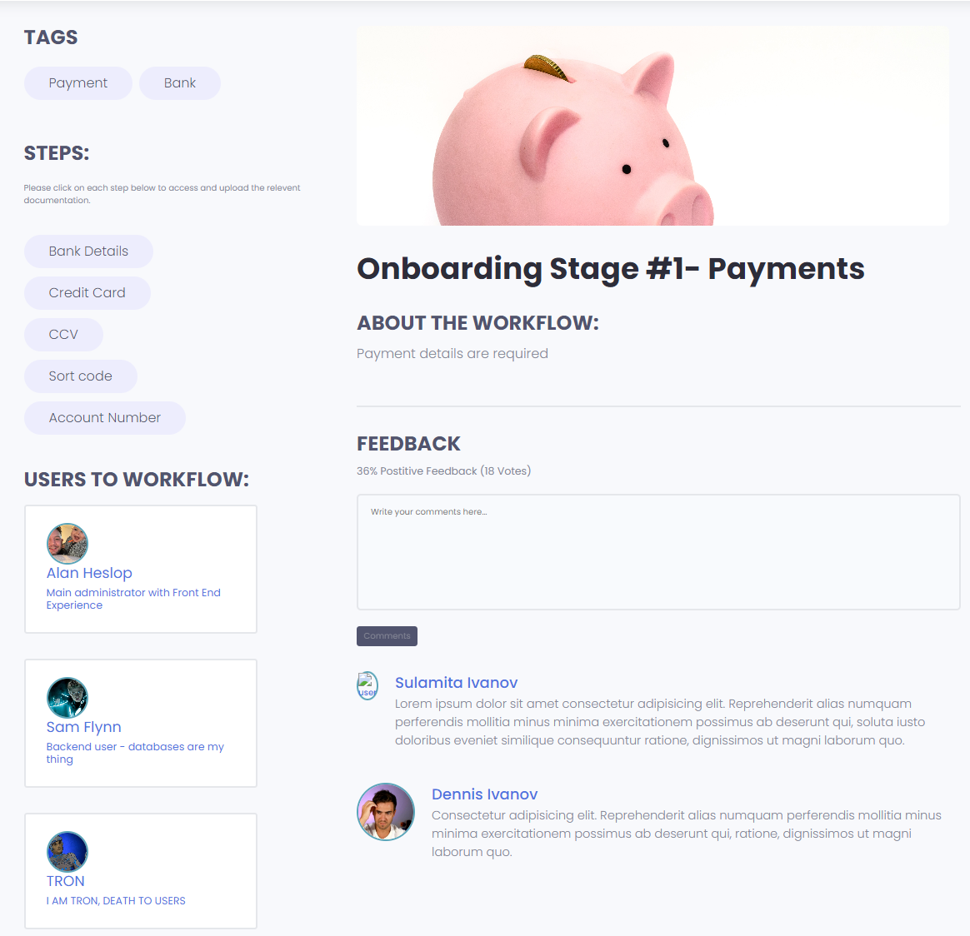

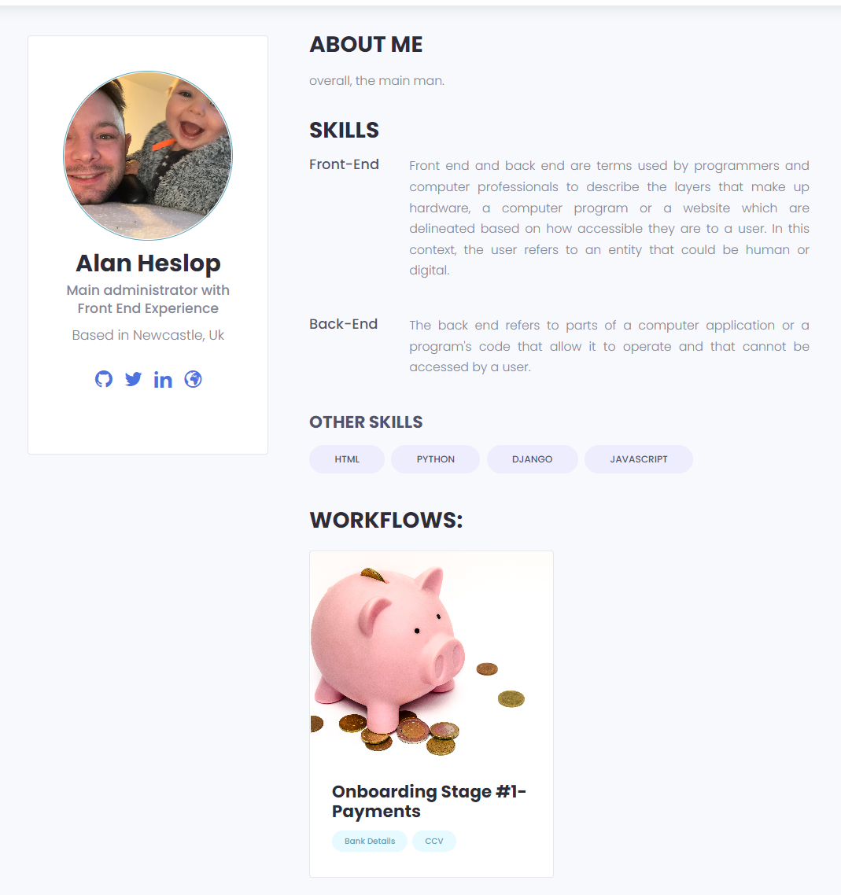






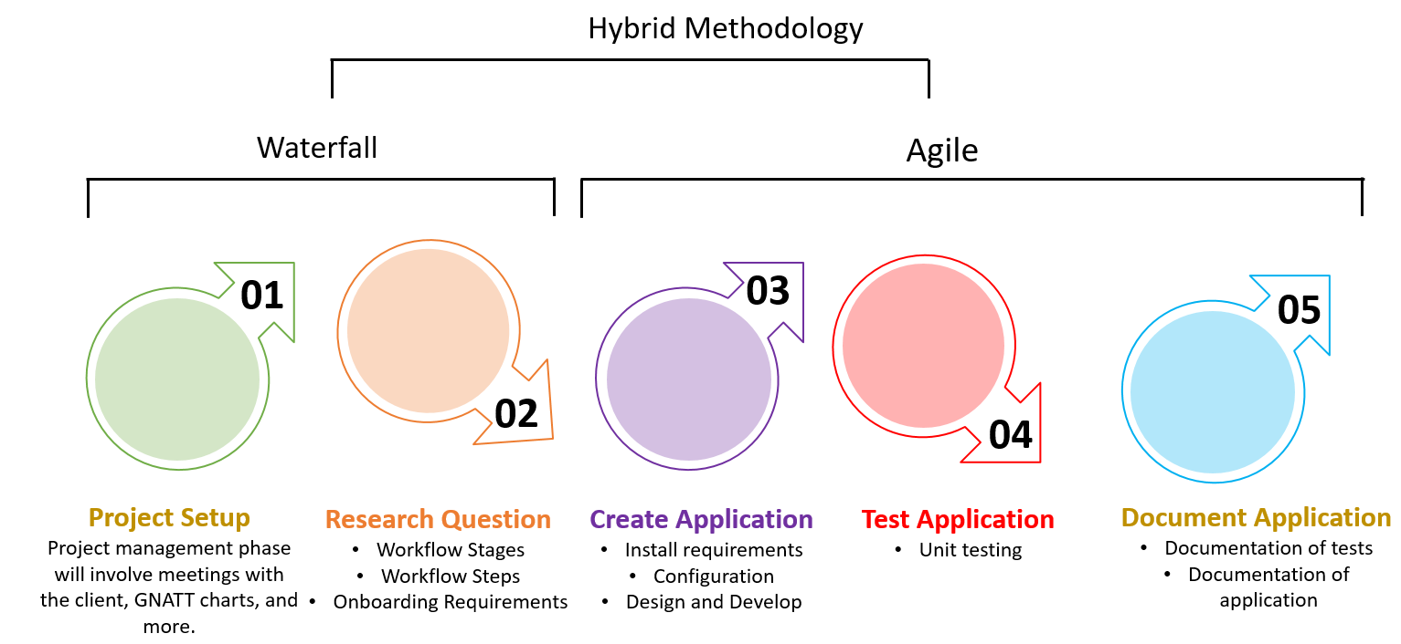

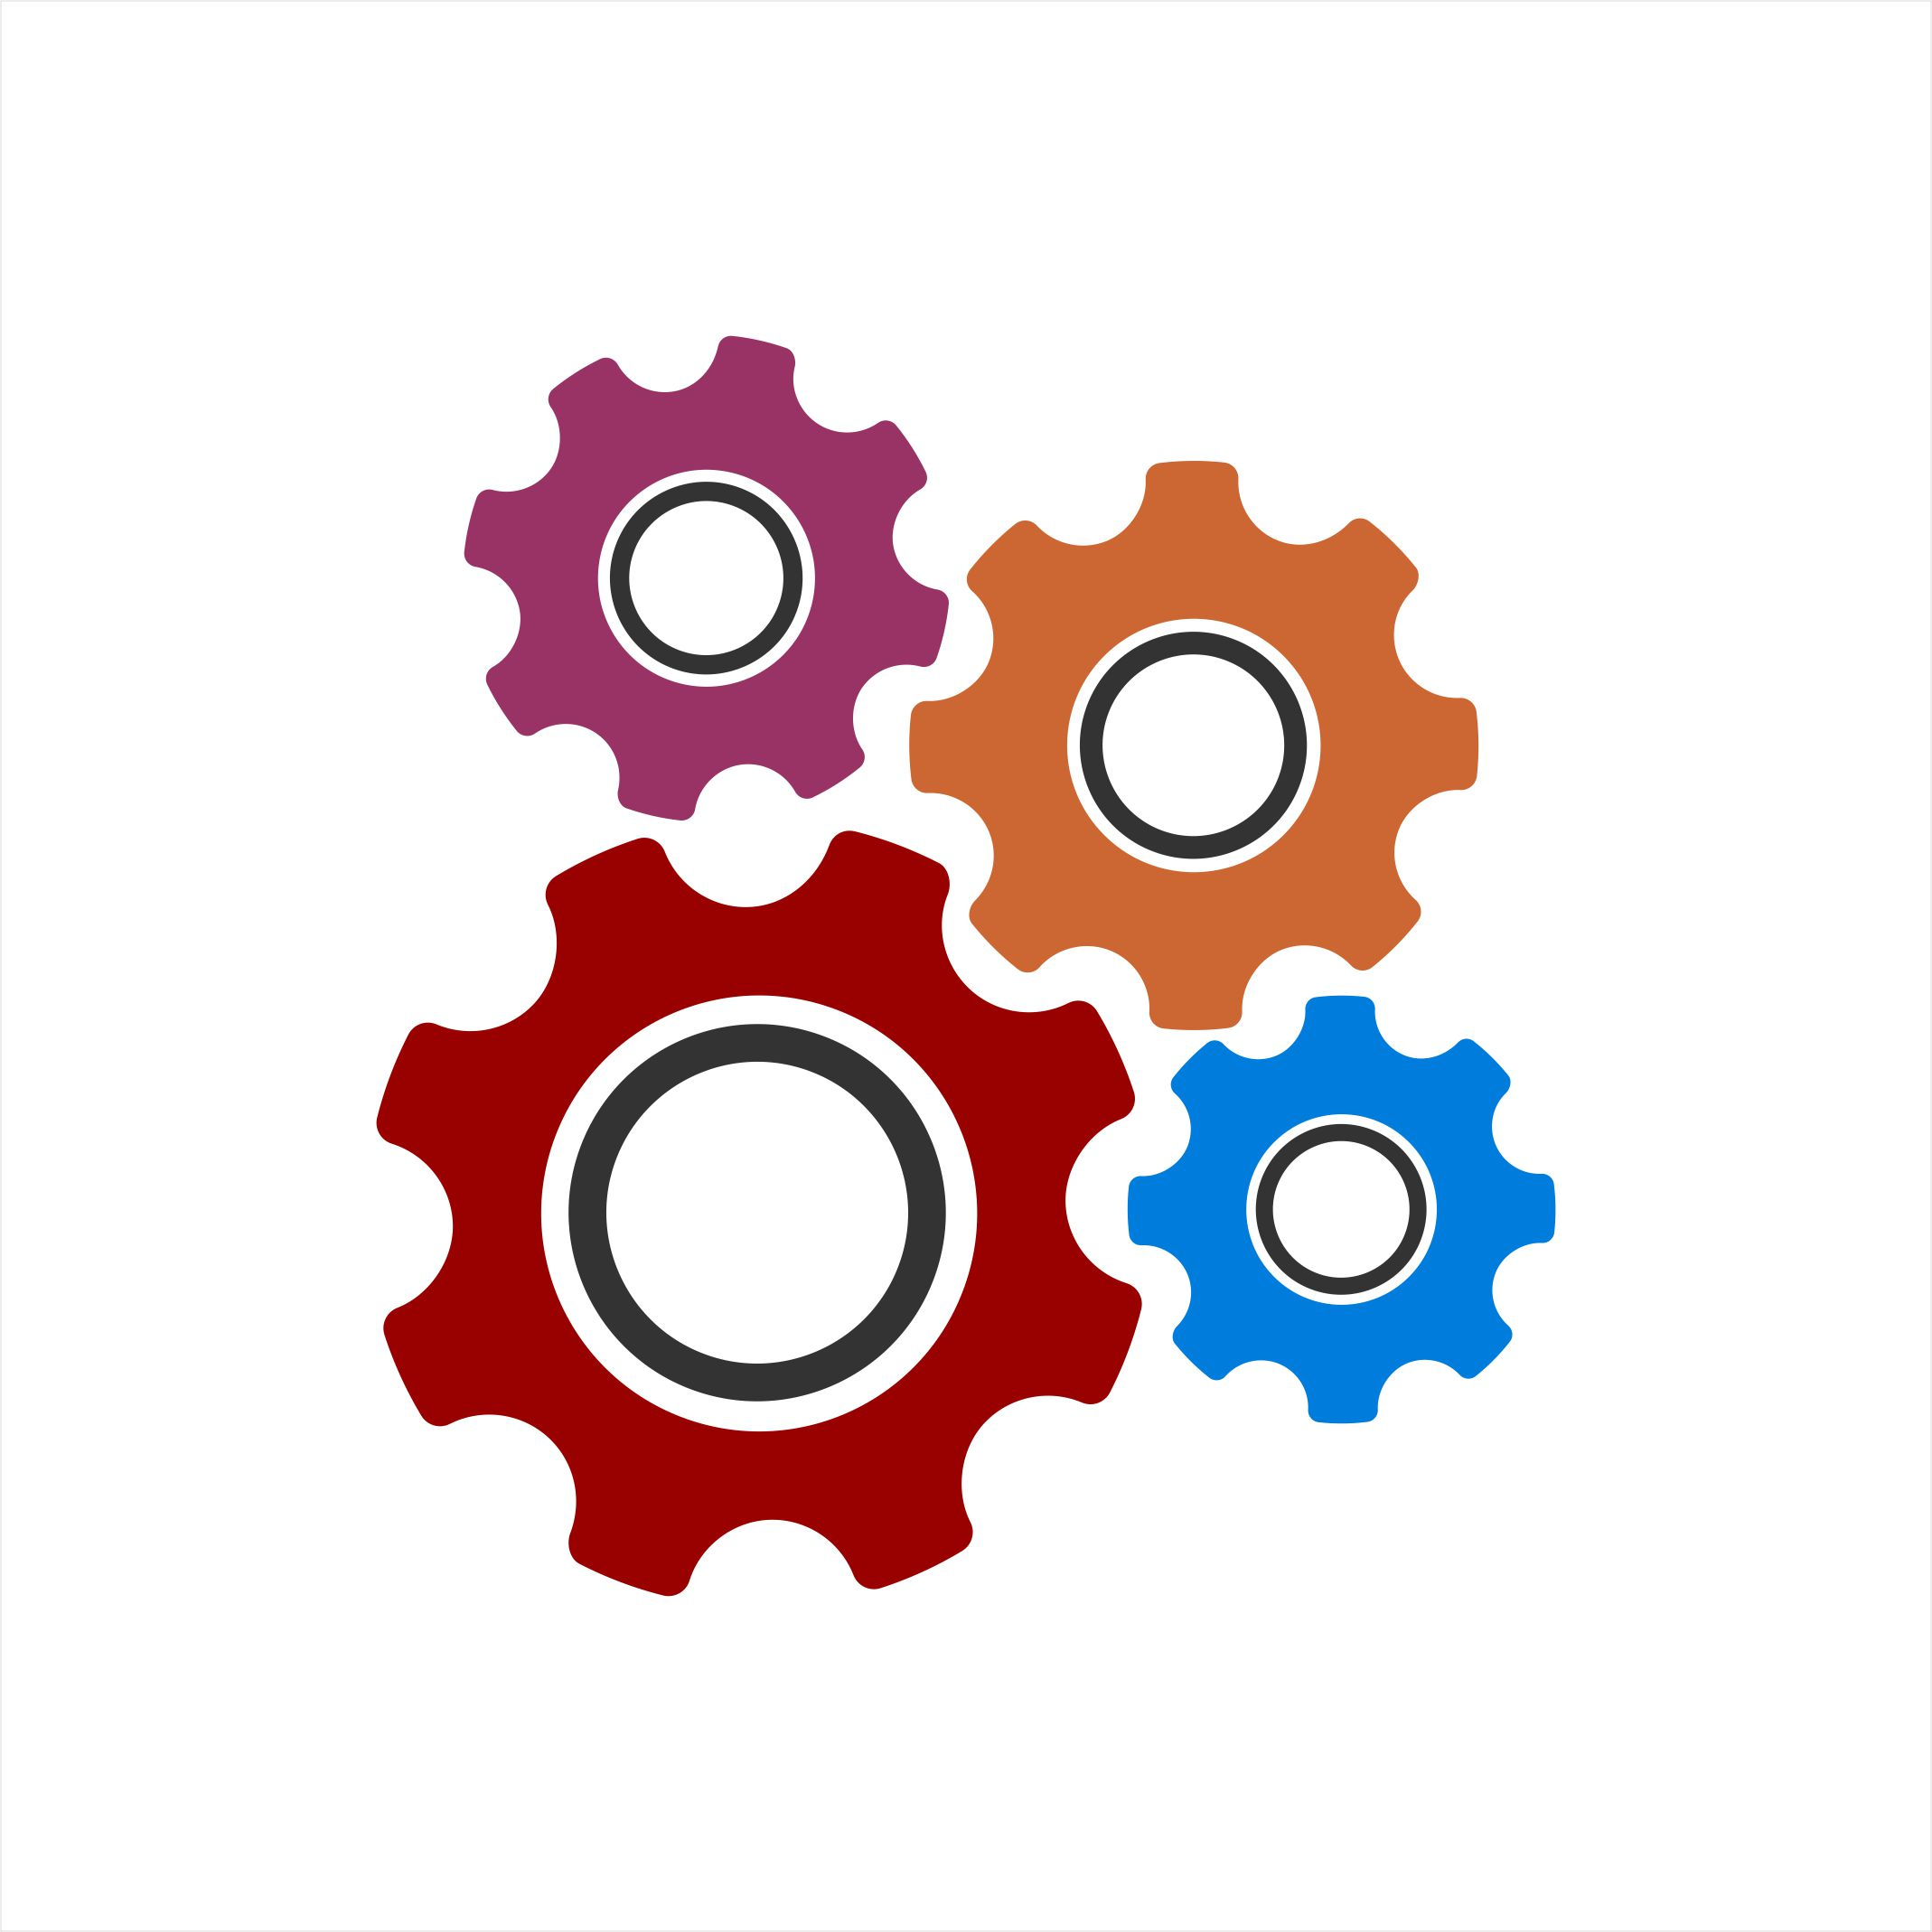
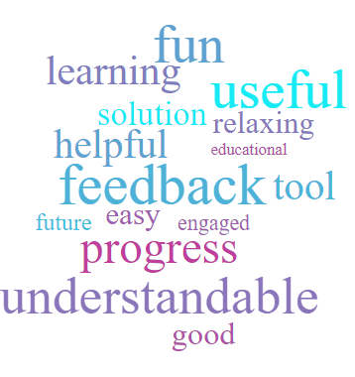
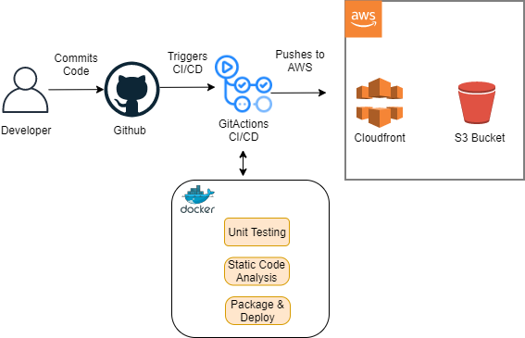
>.
Can Adapting A Workflow Builder Tool Improve the Effectiveness and Result Over Traditional Methods of the Onboarding Process?
DTSL7 – Digital And Technology Solutions Specialist (MSc)
Supervisor: Paul Graham paul.graham@sunderland.ac.uk
Alan Heslop - bh83dl@student.sunderland.ac.uk
Introduction
§v
Problem Context:
Onboarding is vital for the growth of every organisation. However, ongoing challenges can hinder that growth for companies and new employees.
Over 1/3 of companies do not have a structured onboarding process.
The consequences of poor onboarding had led to a major cause of employee turnover.
Project Requirements:
This workflow system can highlight the potential benefit to creating a process which guides the user/hire through a particular process.
Results
Browse Workflow– page will allow the user to select their next packaged workflow (a packaged workflow is a collection of inbuilt steps).
The workflow page can:
Manage workflow.
See related steps.
Review workflow and comments.
Upload documentation.
Users who are assigned to this workflow
Aims & Objectives
§v
Approach
We aimed to design, develop, and implement a Proof of Concept (PoC) to support recruitment through the onboarding process using a workflow system, which provides a 1-2-1 contact with multiple levels of management.
The onboarding objectives were to:
Requirements and Elicitation
Within this section we found that we could use requirements discovery to find the best methods for the customer, requirements workshops to best understand how to perform the methods correctly, and survey (before and after) to better understand the target audience and track progress metrics.
User Page – will show skills, details about user, and the workflows they currently have in progress.
Requirements Discovery
Requirements Workshops
Objective #1
Implement a working PoC utilising full stack front-end and backend concurrent technologies.
Meetings with the client helped to facilitate gathering the facts for the PoC into functional and non-functional requirements.
The workshop will involve understanding the issue, and how to implement a PoC to overcome the current system.
Objective #2
Design a visual front-end to provide the user with the required details.
Survey
Objective #3
A survey will be produced to measure a new hire’s feedback on using the workflow system.
The metrics will be based on a star system (1-5), helping to understand area’s which may need monitoring and improving.
Design, create, and implement a backend to effectively manage user process with CRUD ability.
Objective #4
Process and Methodology
Implement and utilise the CI/CD process using GitHub actions to align more to an Agile method.
Hybrid methodology; Waterfall and Agile would suit this project. As technology is adapting, an iterative approach would used to adapt to changes and influence inputs from the qualitative feedback from user evaluations.
§v
Conclusion
Objective #5
Implement a CI/CD pipeline for continuous improvement of code.
The final product for the PoC met the requirements of the client, who were extremely satisfied of the work carried out and the results. The outcome from the client-side is to collect all information, resources, and links in order to pass this across to a “testing team” for their own development piece. The proposed idea of creating departmental workflows was met with excitement, instead of using the current standard of one size fits all.
Literature Review
Onboarding during Covid-19
The Covid-19 outbreak created a new dynamic across the globe. The outbreak changed face-to-face meetings and began virtual working as a primary method. The demand to work-from-home (WFH) made it difficult to maintain adequate work-family role boundaries (Giurge, Bohns, L., 2020). This idea is backed up with evidence, showing that HR managers are planning, and see WFH as a foundation for the future (Ozimek, 2020). This also shows that the disconnect between employer and employee has a potential negative impact on work status long-term (Weisner & Sutton, 2015).
System Overview
Feedback received (some shown opposite) also identified that the PoC was “up to date, and what the company was missing.”.
In conclusion, it has been shown that the onboarding tool can improve collaboration, retention, and decrease employee turnover which have been identified previously as required areas of improvement.
Using the CI/CD Pipeline helped to keep the code consistent and run through unit tests to ensure the code is safe.
Overall, the feedback was great because I managed this project, set guidelines and timeline and really explored how to improve the organisation in an area it was lacking.
Using a serverless approach, this gives us the ability to commit code to the GitHub repo which triggers a continuous integration testing workflow. The workflow will check consistency in quality of code such as linting, unit testing, and static code analysis.
No onboarding program is perfect, and ineffective onboarding is a great way to lose valuable employees (Scott et al., 2022).
References
Giurge, Bohns, L., 2020. 3 Tips to Avoid WFH Burnout. [online] Harvard Business Review. Available at: <https://hbr.org/2020/04/3-tips-to-avoid-wfh-burnout> [Accessed 16 August 2022].
Ozimek, A., 2020. The Future of Remote Work. SSRN Electronic Journal,.
Notes:
Over 1/3 of companies do not have a structured onboarding process (https://www.businessnewsdaily.com/9936-consequences-poor-onboarding.html)
Employee members image (https://www.pngitem.com/middle/hmhoJRb_happy-employees-transparent-background-hd-png-download/)
Onboarding flow image https://www.pngegg.com/en/png-xofzy
Employee empowerment (https://www.pngegg.com/en/png-pbwgj)
Statistical introduction: https://www.oak.com/blog/employee-onboarding-statistics/

